Slide 1
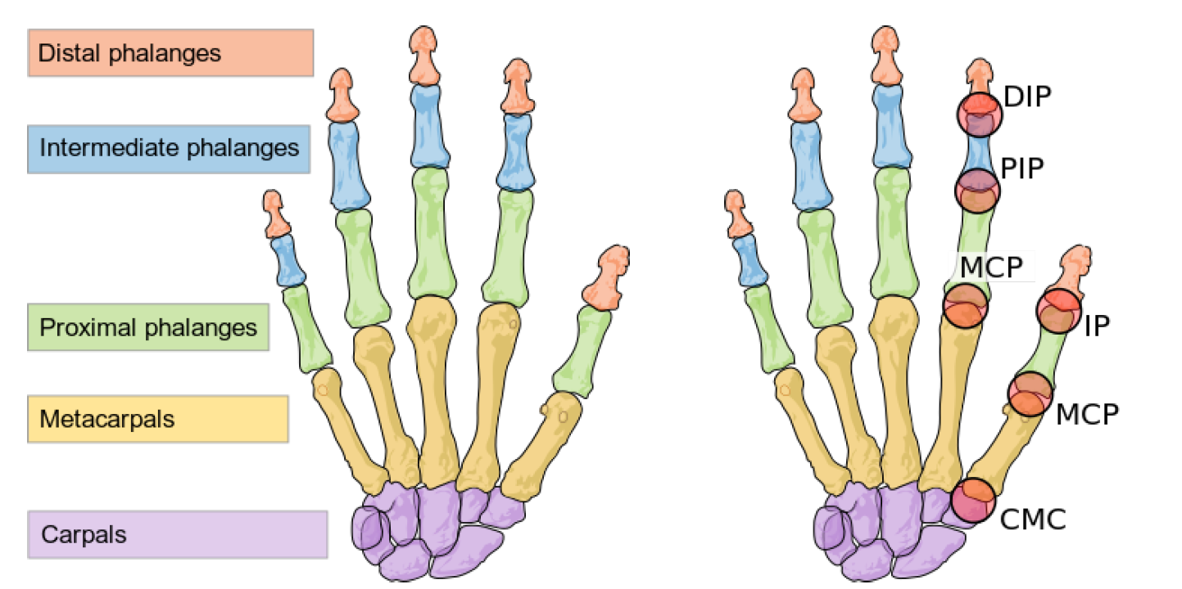
Exercise 1 – Finger modeling and simulating

Slide 2
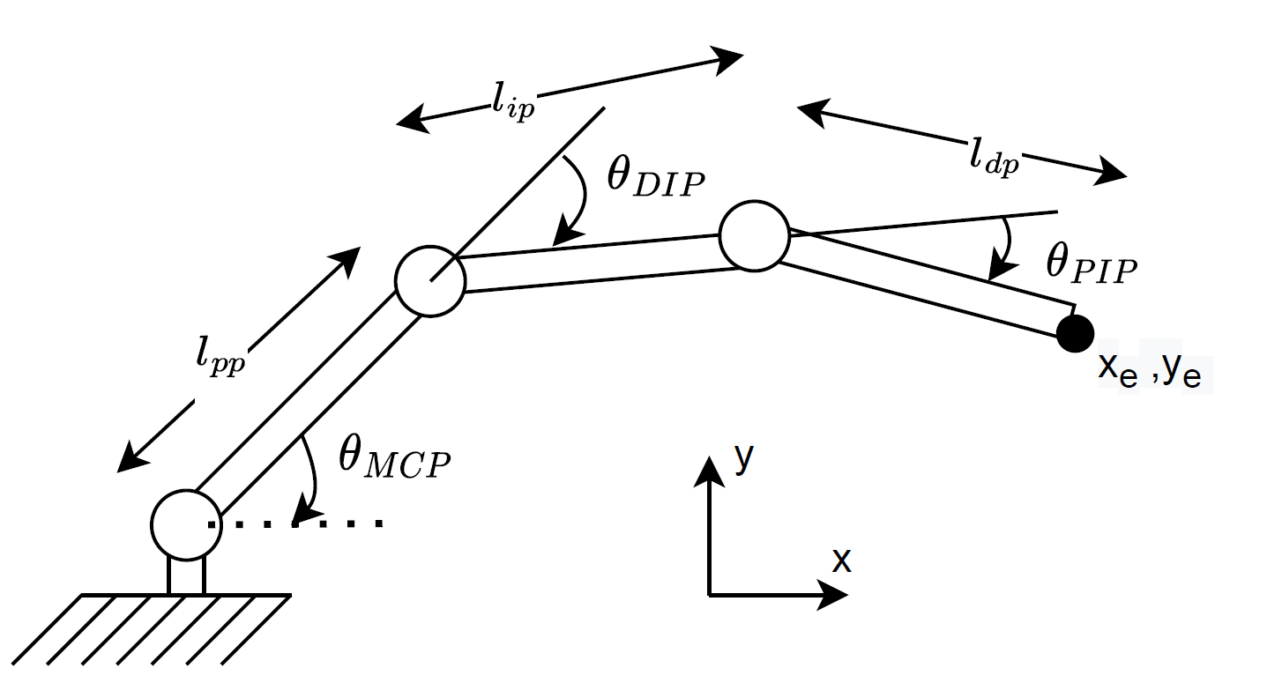
Index finger

Slide 3
Index finger

Slide 4


Index finger

Slide 5
Index finger

Slide 6
Index finger

Slide 7
Index finger

Slide 8


Index finger

Slide 9

Index finger

Slide 10
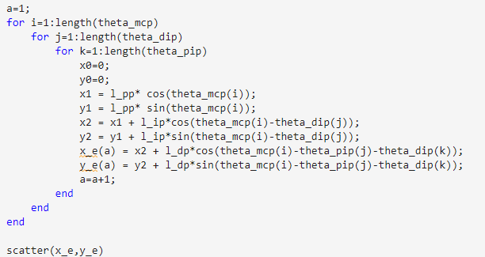
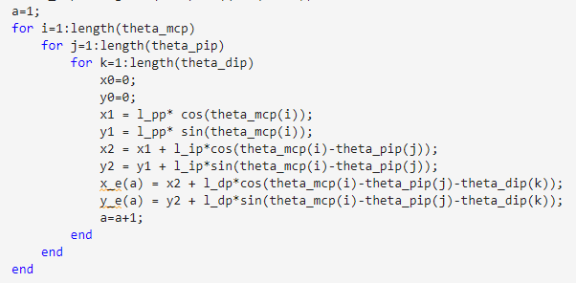
Index finger

Slide 11
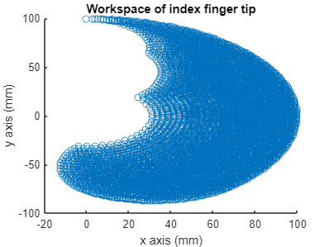
Index finger

Slide 12

Index finger

